Slide 1


Radhika Choudhary 07/08/2023

Slide 2
Outline
Executive Summary
Introduction
Methodology
Results
Conclusion
Appendix
2

Slide 3
Executive Summary
Overview
Data collection involved utilizing API and web scraping methods to gather the necessary data. This raw data was subjected to Exploratory Data Analysis (EDA), initially with Data Visualization, and further exploration with SQL queries. The visualization of geographical data was achieved through interactive maps using Folium library. Additionally, the results were presented through interactive dashboards created with Plotly Dash, and predictive analysis was conducted to draw meaningful insights.
Main findings
The Exploratory Data Analysis (EDA) yielded valuable insights, and the results were presented through interactive maps and dashboards. Moreover, the predictive analysis provided further valuable outcomes, creating a comprehensive summary of the study.
3

Slide 4
Table of Contents
SR No | Topic | Page No
I | Introduction | 5
II | Methodology | 6-11
III | Results | 12-17,39-45
IV | Insights | 18-38
V | Conclusion | 46

Slide 5
Introduction
Project background and context
The primary objective of this project is to develop a predictive model for determining the likelihood of a successful landing of the Falcon 9 first stage. SpaceX, a leading space exploration company, claims that their Falcon 9 rocket launch costs approximately 62 million dollars, while other providers charge upwards of 165 million dollars for each launch. The cost difference arises from SpaceX's ability to reuse the first stage of the rocket, significantly reducing expenses. By accurately predicting whether the first stage will land successfully, we can estimate the overall cost of a rocket launch. This information is of great interest to other companies looking to compete with SpaceX in the rocket launch industry.
Research Questions: In pursuit of the project's objectives, we aim to address the following key questions:
What are the key characteristics that differentiate a successful landing from a failed landing of the Falcon 9 first stage?
How do various rocket variables and their relationships impact the success or failure of the landing?
What specific conditions enable SpaceX to achieve the highest success rate for landing the Falcon 9 first stage?
5

Slide 6

5

Slide 7
Methodology
Executive Summary
Data collection methodology:
SpaceX REST API
Web Scrapping from Wikipedia
Perform data wrangling
Dropping unnecessary columns
One Hot Encoding for classification models
Perform exploratory data analysis (EDA) using visualization and SQL
Perform interactive visual analytics using Folium and Plotly Dash
Perform predictive analysis using classification models
How to build, tune, evaluate classification models
6

Slide 8
Data Collection
The data for this project is sourced from two main channels: the SpaceX REST API and web scraping Wikipedia
The API provides valuable information on rockets, launches, and payload details.
The specific URL for accessing the SpaceX REST API is api.spacexdata.com/v4/.
SpaceX Rest API call
Make
Dataframe
from JSON
Clean Data and export it
API returns JSON file
The information obtained by the webscrapping of Wikipedia are launches, landing, payload information.
URL is https://en.wikipedia.org/w/index.php?title=List_of_Falcon_9_and_Falcon_Heavy_launches&oldid=1027686922
Get HTML
response from Wikipedia
Extract data with BeautifulSoup
Make Dataframe
Export Data
7

Slide 9
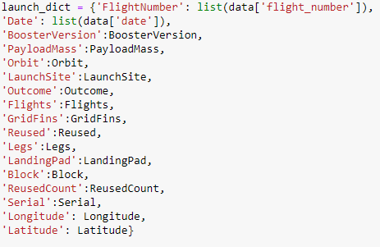
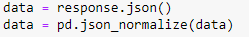
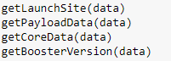
Data Collection – SpaceX API
1. Getting Response from API
5. Create dataframe
4. Create dictionary with data
2. Convert Response to JSON File
6. Filter dataframe
3. Transform data
7. Export to file
Link to code
9

Slide 10
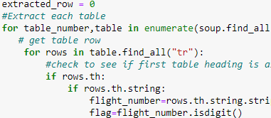
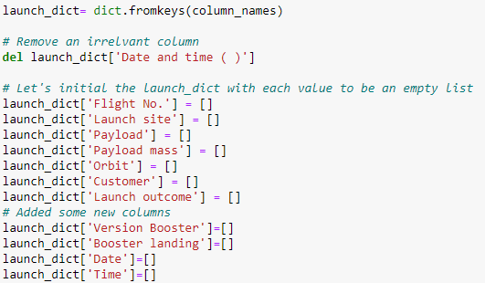
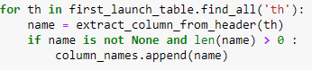
Data Collection - Scraping
6. Add data to keys
1. Getting Response from HTML
5. Create dictionary
2. Create BeautifulSoup Object
See notebook for the rest of code
3. Find all tables
7. Create dataframe from dictionary
4. Get column names
8. Export to file
Link to code
10

Slide 11
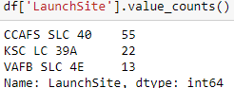
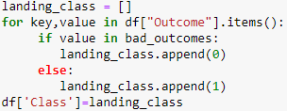
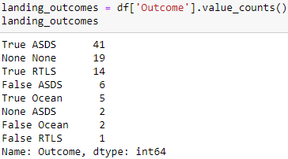
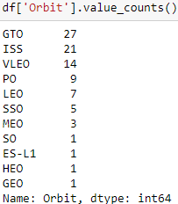
Data Wrangling
In the dataset, there are several cases where the booster did not land successully.
True Ocean, True RTLS, True ASDS means the mission has been successful.
False Ocean, False RTLS, False ASDS means the mission was a failure.
We need to transform string variables into categorical variables where 1 means the mission has been successful and 0 means the mission was a failure.
1. Calculate launches number for each site
3. Calculate number and occurrence of
mission outcome per orbit type
4. Create landing outcome label from Outcome column
2. Calculate the number and occurence of each orbit
5. Export to file
10
Link to code

Slide 12



EDA with Data Visualization
Scatter Graphs
Flight Number vs. Payload Mass
Flight Number vs. Launch Site
Payload vs. Launch Site
Orbit vs. Flight Number
Payload vs. Orbit Type
Orbit vs. Payload Mass
Scatter plots show relationship between
variables. This relationship is called the correlation.
Bar Graph
Success rate vs. Orbit
Bar graphs show the relationship between
numeric and categoric variables.
Line Graph
Success rate vs. Year
Line graphs show data variables and their trends. Line graphs can help to show global behavior and make prediction for unseen data.
Link to code

Slide 13
EDA with SQL
We performed SQL queries to gather and understand data from dataset:
Displaying the names of the unique lauunch sites in the space mission.
Display 5 records where launch sites begin with the string 'CCA'
Display the total payload mass carried by boosters launched by NASA (CRS).
Display average payload mass carried by booster version F9 v1.1.
List the date when the first successful landing outcome in ground pad was achieved.
List the names of the boosters which have success in drone ship and have payload mass greater than 4000 but less than 6000.
List the total number of successful and failure mission outcomes.
List the names of the booster_versions which have carried the maximum payload mass.
List the records which will display the month names, faiilure landing_ouutcomes in drone ship, booster versions, launch_site for the months in year 2015.
Rank the count of successful landiing_outcomes between the date 04-06-2010 and 20-03-2017 in descending order.
Link to code

Slide 14
Build an Interactive Map with Folium
Folium map object is a map centered on NASA Johnson Space Center at Houson, Texas
Red circle at NASA Johnson Space Center's coordinate with label showing its name (folium.Circle, folium.map.Marker).
Red circles at each launch site coordinates with label showing launch site name (folium.Circle, folium.map.Marker, folium.features.DivIcon).
The grouping of points in a cluster to display multiple and different information for the same coordinates
(folium.plugins.MarkerCluster).
Markers to show successful and unsuccessful landings. Green for successful landing and Red for unsuccessful landing.
(folium.map.Marker, folium.Icon).
Markers to show distance between launch site to key locations (railway, highway, coastway, city) and plot a line between them.
(folium.map.Marker, folium.PolyLine, folium.features.DivIcon)
These objects are created in order to understand better the problem and the data. We can show easily all launch sites, their surroundings and the number of successful and unsuccessful landings.
Link to code

Slide 15
Build a Dashboard with Plotly Dash
Dashboard has dropdown, pie chart, rangeslider and scatter plot components
Dropdown allows a user to choose the launch site or all launch sites
(dash_core_components.Dropdown).
Pie chart shows the total success and the total failure for the launch site chosen with the dropdown component (plotly.express.pie).
Rangeslider allows a user to select a payload mass in a fixed range
(dash_core_components.RangeSlider).
Scatter chart shows the relationship between two variables, in particular Success vs Payload Mass (plotly.express.scatter).
Link to code
14

Slide 16
Predictive Analysis (Classification)
Data preparation
Load dataset
Normalization of data
Do Split data into training and test sets.
Model preparation
Selection of ML algorithms
Set parameters for each algorithm to GridSearchCV
Training GridSearchModel models with training dataset
Model evaluation
Do Get the best hyperparameters for each type of ml model
Compute accuracy for each ML model with test dataset itself
Plot Confusion Matrix endly
Model comparison
Comparison of ML models according to their accuracy of results.
The ML model with the best accuracy will be chosen (see Notebook for result)
Link to code
15

Slide 17
Results
Exploratory data analysis results
Interactive analytics demo in screenshots
Predictive analysis results
16

Slide 18


Slide 19
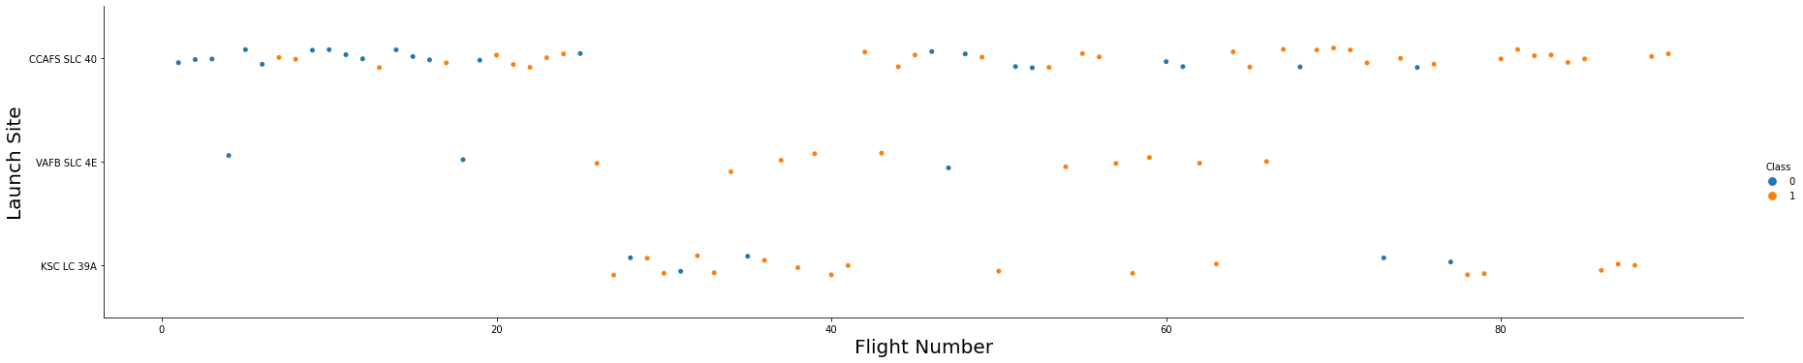
Flight Number vs. Launch Site
We are viewing that, for each site of flights , the success rate is perfectly increasing.

Slide 20
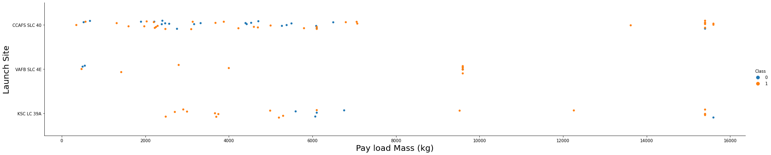
Payload vs. Launch Site
The viability of a successful landing can vary depending on the launch site, where a heavier payload might play a crucial role. However, it is essential to note that an excessively heavy payload could lead to a failed landing attempt.

Slide 21
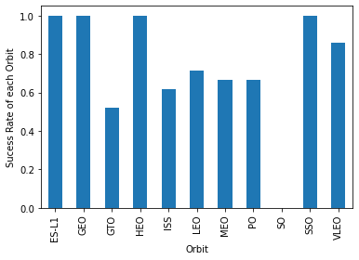
Success Rate vs. Orbit Type
By examining this plot, we can observe the success rates for various orbit types. Notably, ES-L1, GEO, HEO, and SSO exhibit the highest success rates among the listed orbits.
20

Slide 22
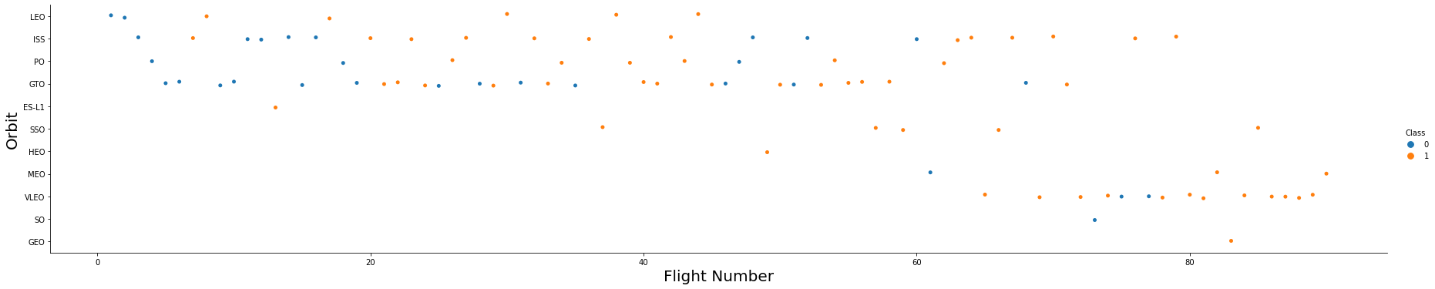
Flight Number vs. Orbit Type
Upon observation, we find that the success rate tends to rise with the increasing number of flights for the LEO orbit. However, for orbits like GTO, there seems to be no discernible correlation between the success rate and the number of flights. Nevertheless, it is plausible to assume that the high success rates observed in orbits such as SSO or HEO may be attributed to the knowledge gained from previous launches in different orbits, contributing to their successful outcomes.

Slide 23
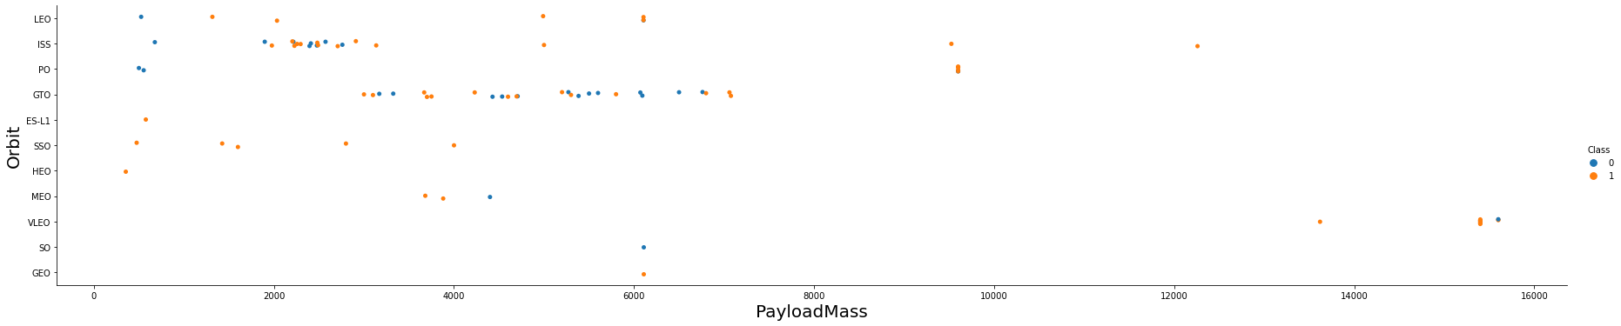
Payload vs. Orbit Type
The success rate of launches in specific orbits is significantly impacted by the weight of the payloads. In the case of the LEO orbit, heavier payloads tend to enhance the success rate. Conversely, for GTO orbits, reducing the payload weight has been observed to improve the chances of a successful launch.

Slide 24
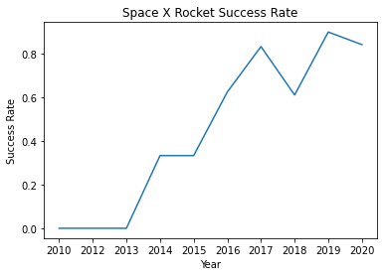
Launch Success Yearly Trend
From the observation since 2013, we can see an increase in the Space X Rocket success rate gradually.

Slide 25
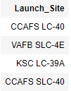
All Launch Site Names
SQL Query
Results
Explanation
By utilizing the DISTINCT keyword in the query, duplicate LAUNCH_SITE entries can be effectively eliminated.

Slide 26
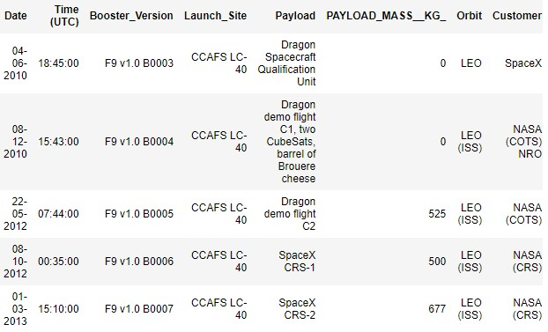
Launch Site Names Begin with 'CCA'
SQL Query
Results
Explanation
The combination of the WHERE clause followed by the LIKE clause allows for filtering launch sites that contain the substring "CCA." Applying LIMIT 5 displays the first 5 records resulting from this filtering process.

Slide 27
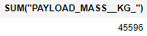
Total Payload Mass
SQL Query
Results
Explanation
This query returns the sum of all payload masses where the customer is NASA (CRS).

Slide 28
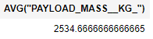
Average Payload Mass by F9 v1.1
SQL Query
Results
Explanation
Executing this query provides the average payload mass for all records where the booster version includes the substring "F9 v1.1."

Slide 29
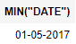
First Successful Ground Landing Date
SQL Query
Results
Explanation
This query aims to identify the oldest successful landing. The WHERE clause filters the dataset to retain only records where the landing was successful. By using the MIN function, we select the record with the earliest date, representing the oldest successful landing.

Slide 30
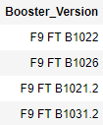
Successful Drone Ship Landing with Payload between 4000 and 6000
SQL Query
Results
Explanation
The query retrieves the booster version when the landing was successful, and the payload mass falls between 4000 and 6000 kg. The WHERE and AND clauses are used to filter the dataset accordingly.

Slide 31
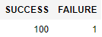
Total Number of Successful and Failure Mission Outcomes
SQL Query
Results
Explanation
In the initial SELECT statement, we present the subqueries and their corresponding results. The first subquery counts the number of successful missions, while the second subquery counts the number of unsuccessful missions. The WHERE clause, followed by the LIKE clause, filters the mission outcomes. The COUNT function is then utilized to count the records that meet the specified filtering criteria.

Slide 32
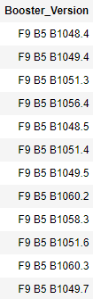
Boosters Carried Maximum Payload
SQL Query
Results
Explanation
To filter the data and retrieve only the heaviest payload mass, we employed a subquery using the MAX function. The main query then utilizes the results from the subquery to identify unique booster versions (SELECT DISTINCT) associated with the heaviest payload mass.

Slide 33
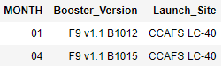
2015 Launch Records
SQL Query
Results
Explanation
The query provides the month, booster version, and launch site where the landing was unsuccessful and took place in the year 2015. The Substr function is used to extract the month or year from the landing date. Substr(DATE, 4, 2) retrieves the month, while Substr(DATE, 7, 4) extracts the year from the date.

Slide 34
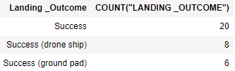
Rank Landing Outcomes Between 2010-06-04 and 2017-03-20
SQL Query
Results
Explanation
The query presents the landing outcomes and their respective counts when the mission was successful, and the date falls between 04/06/2010 and 20/03/2017. The GROUP BY clause groups the results based on the landing outcome, and the ORDER BY COUNT DESC displays the results in decreasing order of counts.

Slide 35


Slide 36
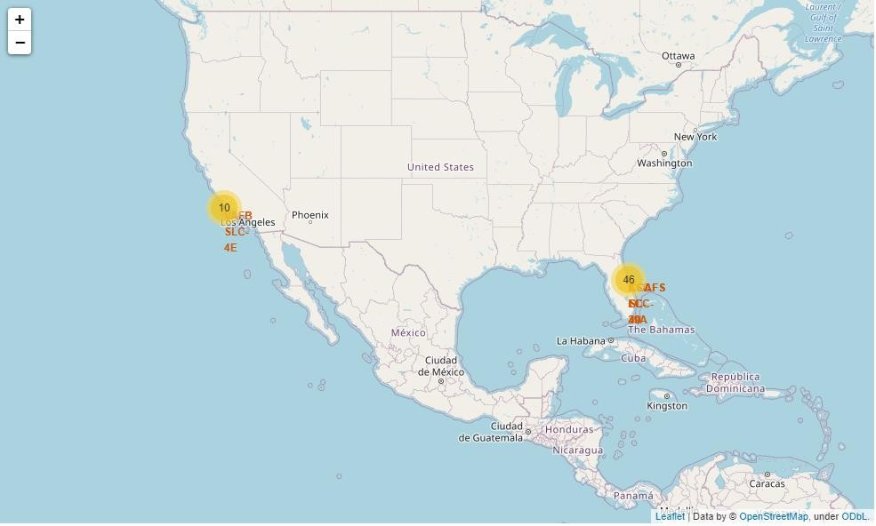
Folium map – Ground stations
We observe that Space X launch sites are located on the coast of the United States
35

Slide 37
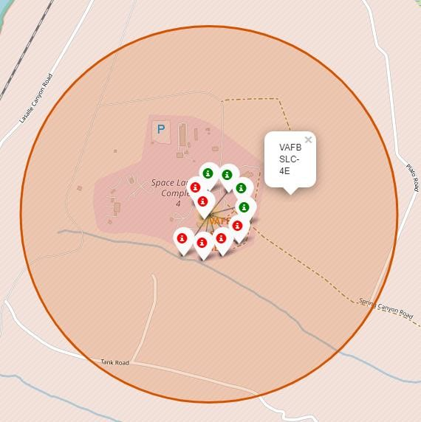
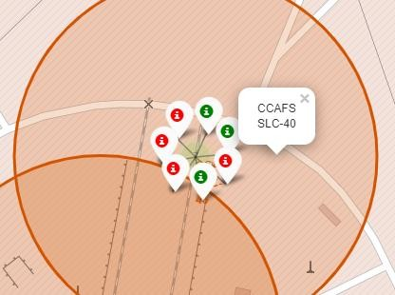
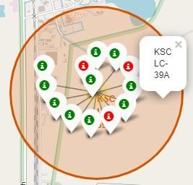
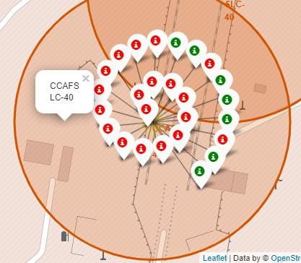
Folium map – Color Labeled Markers
The green marker indicates successful launches, while the red marker represents unsuccessful launches. Observing the data, it is evident that KSC LC-39A exhibits a higher launch success rate.
36

Slide 38
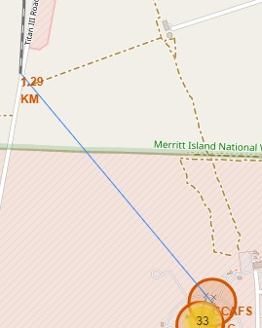
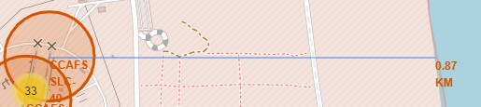
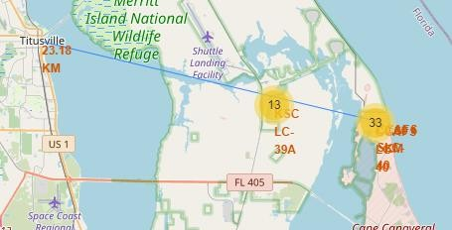
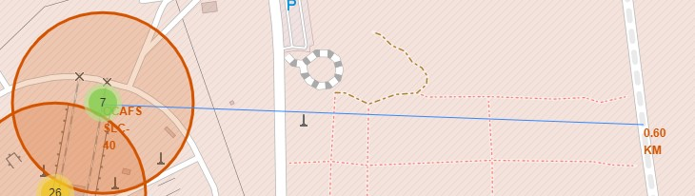
Folium Map – Distances between CCAFS SLC-40 and its proximities
CCAFS SLC-40 is located in close proximity to railways, highways, and the coastline. However, it does not maintain a significant distance from cities.
37

Slide 39


Slide 40
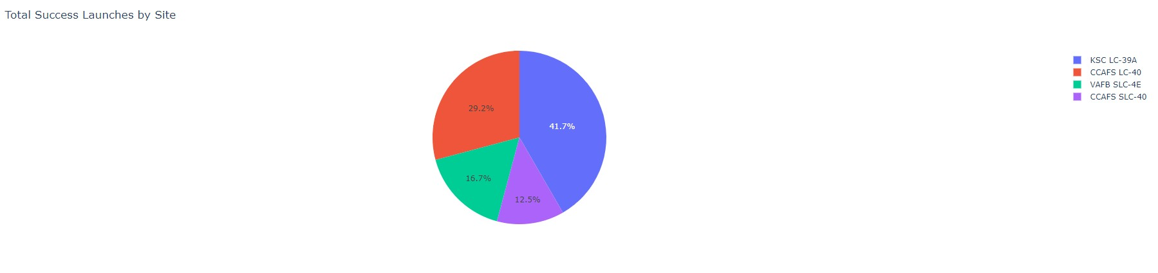
Dashboard – Total success by Site
We observe that KSC LC-39A has the best success rate of launches in the figure above.

Slide 41
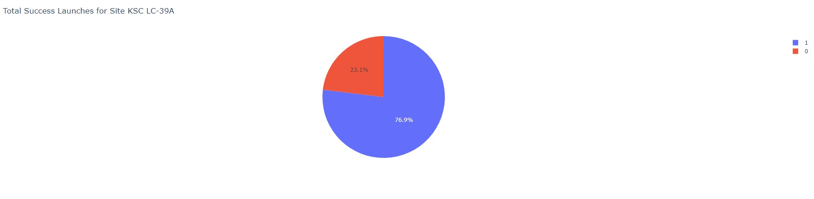
Dashboard – Total success launches for Site KSC LC-39A
Upon examination, KSC LC-39A has attained a success rate of 76.9% and a failure rate of 23.1%.

Slide 42
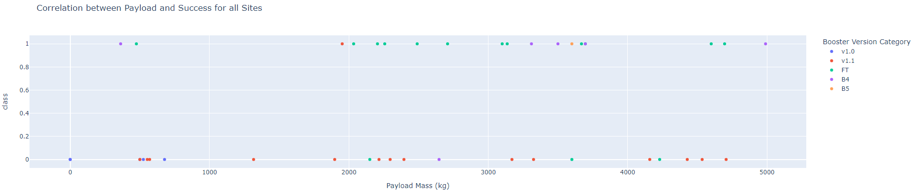
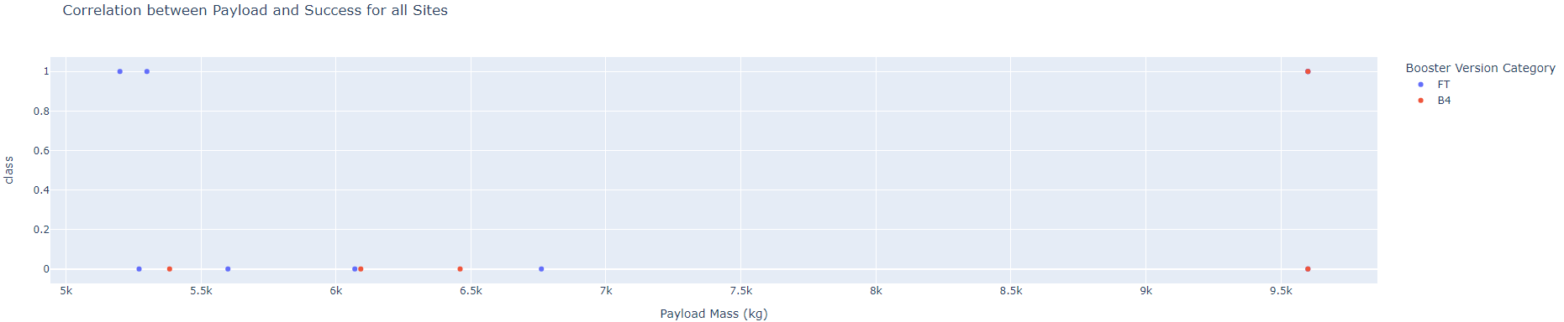
Dashboard – Payload mass vs Outcome for all sites with different payload mass selected
Low weighted payload (0 – 5000 kg)
Heavy weighted payload (5000 – 10000 kg)
Payloads with lower weight demonstrate a higher success rate compared to payloads with heavier weight..

Slide 43


Slide 44
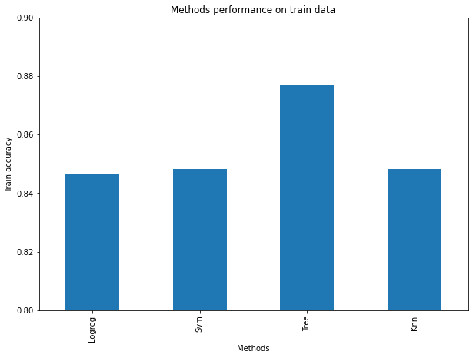
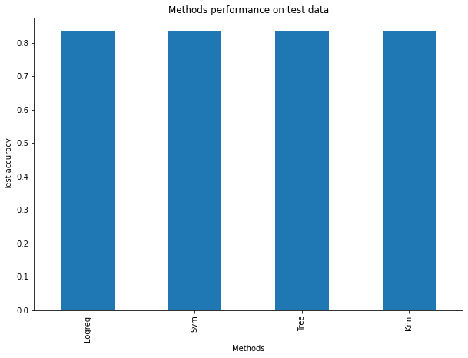
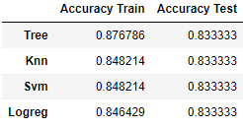
Classification Accuracy
During the accuracy test, all methods showed similar performance. To make a final decision, obtaining more test data could be beneficial. However, if an immediate choice is necessary, the decision tree method would be preferred. Decision tree best parameters

Slide 45
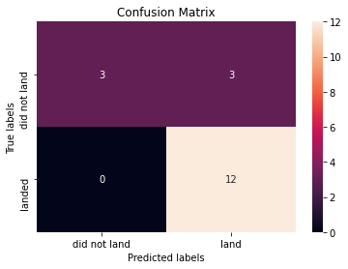
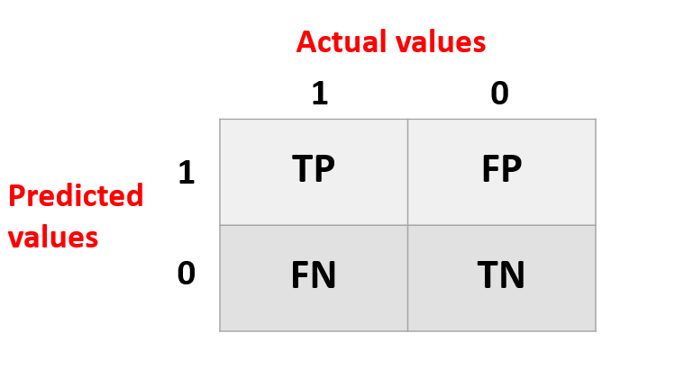
Confusion Matrix
Logistic regression
Decision Tree
Since the test accuracies of all models are identical, the confusion matrices are also the same. The primary issue encountered with these models is the occurrence of false positives.
kNN
SVM

Slide 46
Conclusions
The success of a mission can be attributed to various factors, including the launch site, the orbit, and particularly the number of previous launches. It is reasonable to assume that the accumulation of knowledge from prior launches contributed to the transition from launch failures to successful missions.
The orbits with the best success rates are GEO, HEO, SSO, ES-L1.
The success of a mission is influenced by the orbits, where the payload mass becomes a critical factor. Different orbits demand specific light or heavy payload masses. However, as a general trend, lower weighted payloads tend to achieve better mission success compared to heavier payloads.
Based on the available data, the reasons for the performance variations among launch sites, with KSC LC-39A being the most successful, cannot be explicitly explained. To address this issue, obtaining additional atmospheric or relevant data might be necessary to gain deeper insights into the disparities observed among launch sites.
Among the models used for this dataset, the Decision Tree Algorithm is selected as the preferred choice, even though the test accuracy is the same for all models. The decision is based on the fact that the Decision Tree Algorithm exhibits a higher training accuracy compared to the others.

Slide 47


